Slide 1
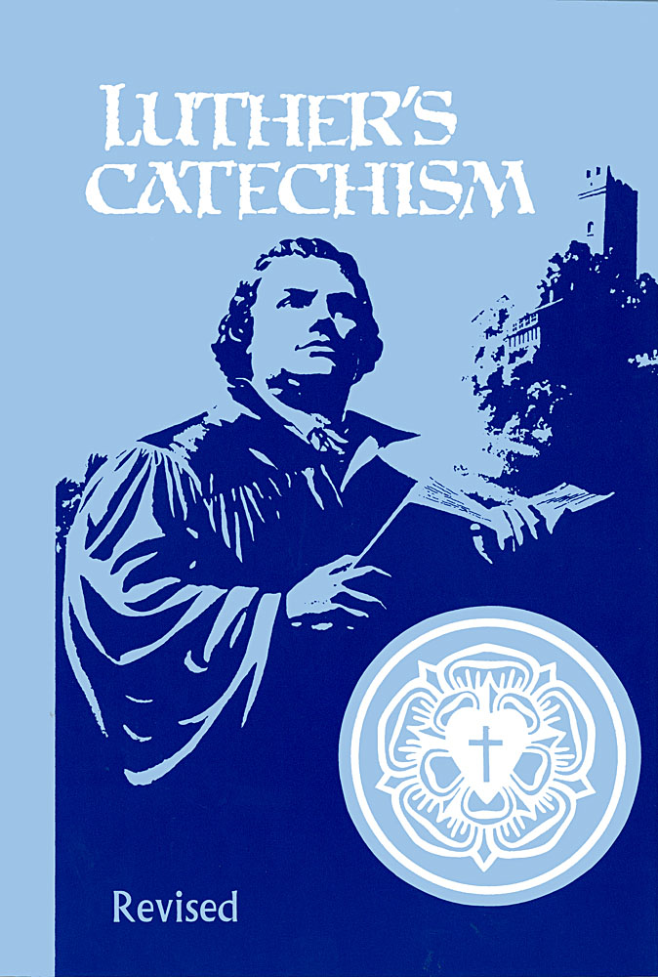
What Are The Bible’s
Two Main Teachings?
Catechism Questions 13-17
January 28, 2018

Slide 2
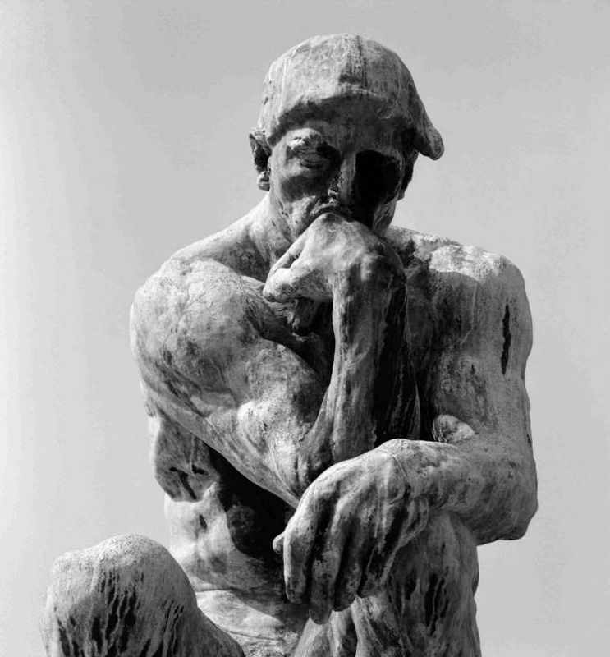
What does my natural knowledge tell me about God?
It tells me that there is a God who will judge me guilty for my sins. It is the Bible’s revealed knowledge that I find my salvation in Jesus.

Slide 3
How did God write the Bible?
God wrote the Bible by verbal inspiration so that I may be sure that it is the truth and is trustworthy in all it says.

Slide 4
What are the Bible’s
two main teachings?

Slide 5
What Are The Bible’s
Two Main Teachings?
Catechism Questions 13-17
January 28, 2018

Slide 6
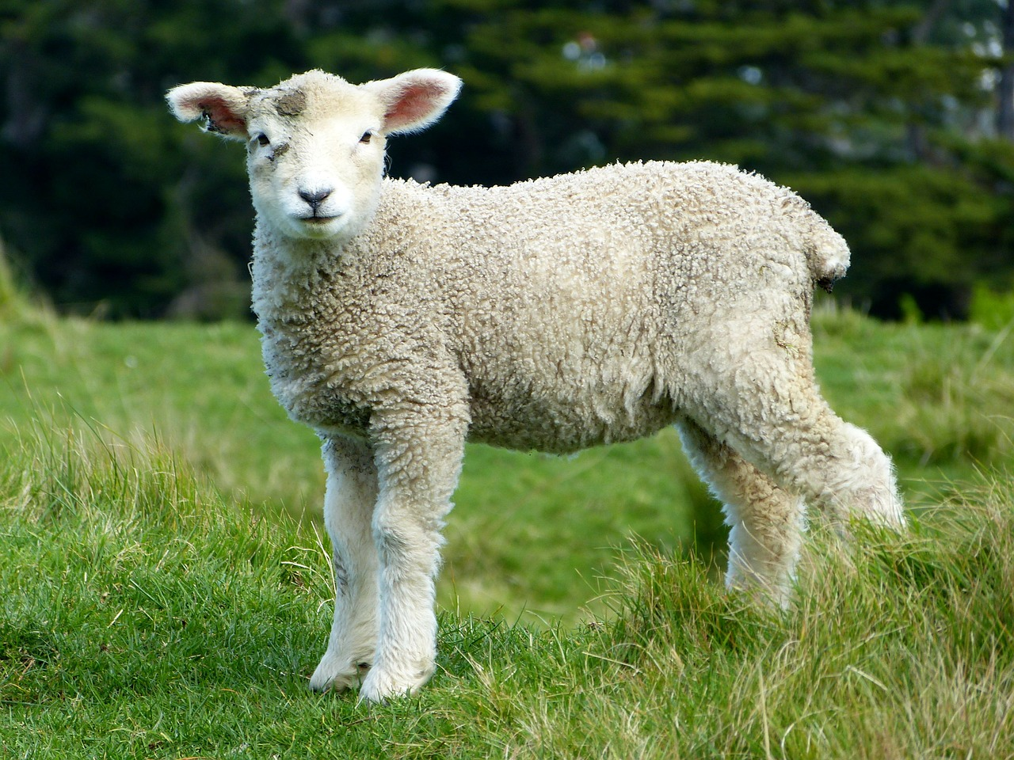
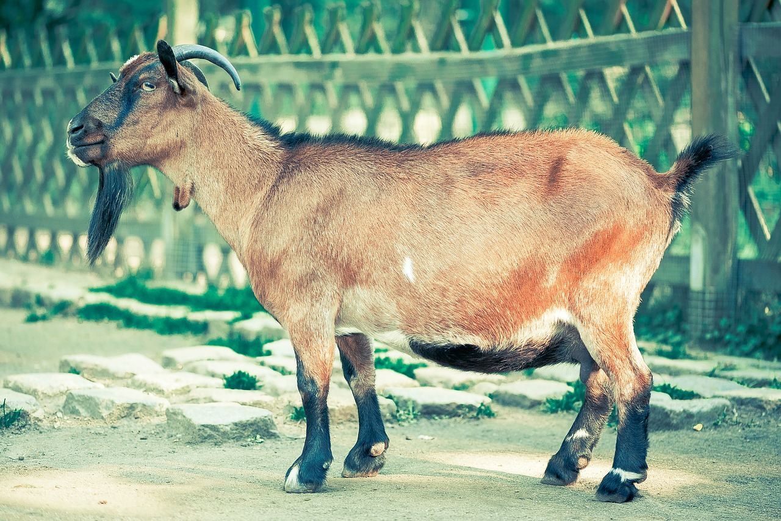
The Sheep
and the Goats
Matthew
25:31-34,41,46

Slide 7
Why did the sheep on Jesus’ right receive eternal life?
They were declared righteous, that is,
forgiven by God.
Why did the goats on Jesus’ left
receive eternal punishment?
They were still covered in their sins.

Slide 8
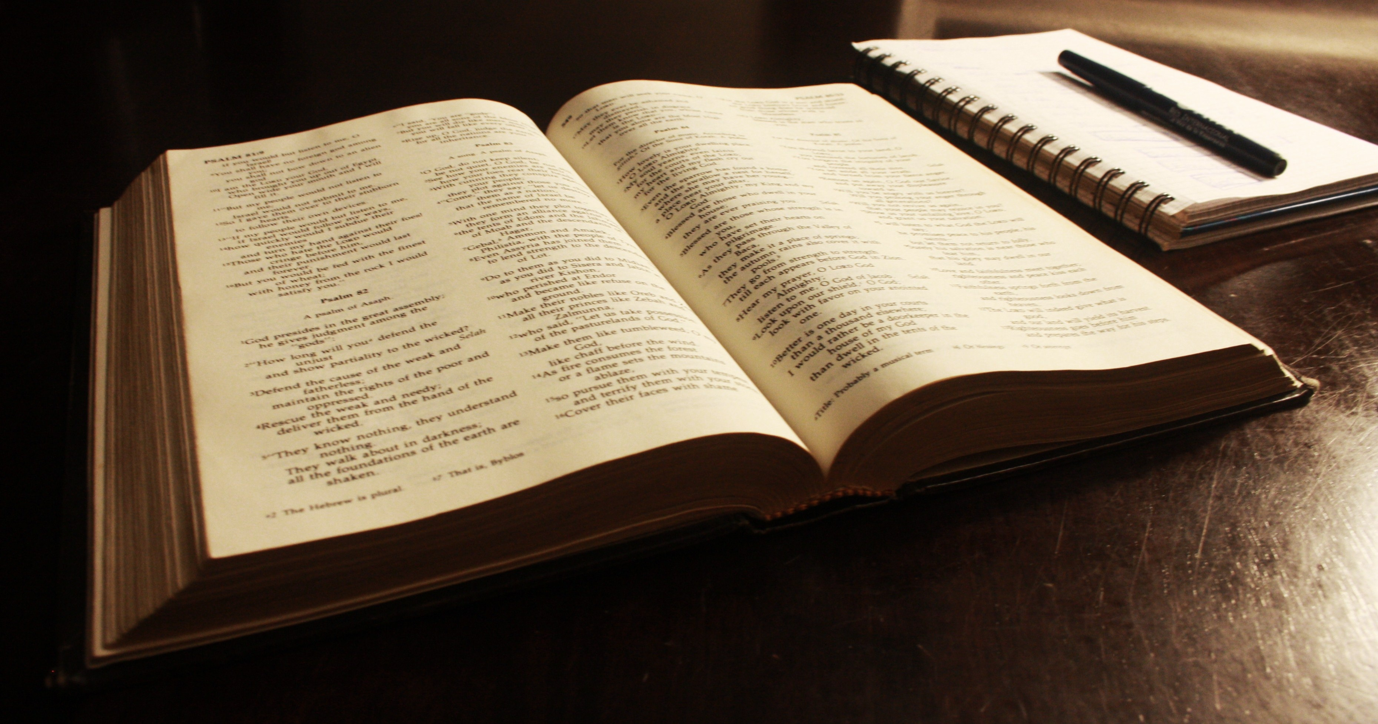
Matthew 19:16-19; Romans 6:23a

Slide 9
What does God’s law tell me?
God’s law teaches me what to do and what not to do. Because I have failed to perfectly keep it, I deserve eternal punishment in hell.

Slide 10
The Sheep
and the Goats
Matthew
25:31-34,41,46

Slide 11
John 1:29; Romans 6:23b

Slide 12
What does God’s gospel tell me?
God’s gospel tells me that Jesus took my sins away and gives me eternal life even though I am a sinner.

Slide 13
The Sheep
and the Goats
Matthew
25:31-34,41,46

Slide 14
John 20:30,31

Slide 15
What is the main purpose of the Bible?
To lead me to believe in Jesus so that I may have hope now and forever.

Slide 16
What is SOS of God’s law?
S
O
S
hows
ur
ins

Slide 17
What is SOS of God’s gospel?
S
O
S
hows
ur
avior

Slide 18
The Sheep
and the Goats
Matthew
25:31-34,41,46

Slide 19
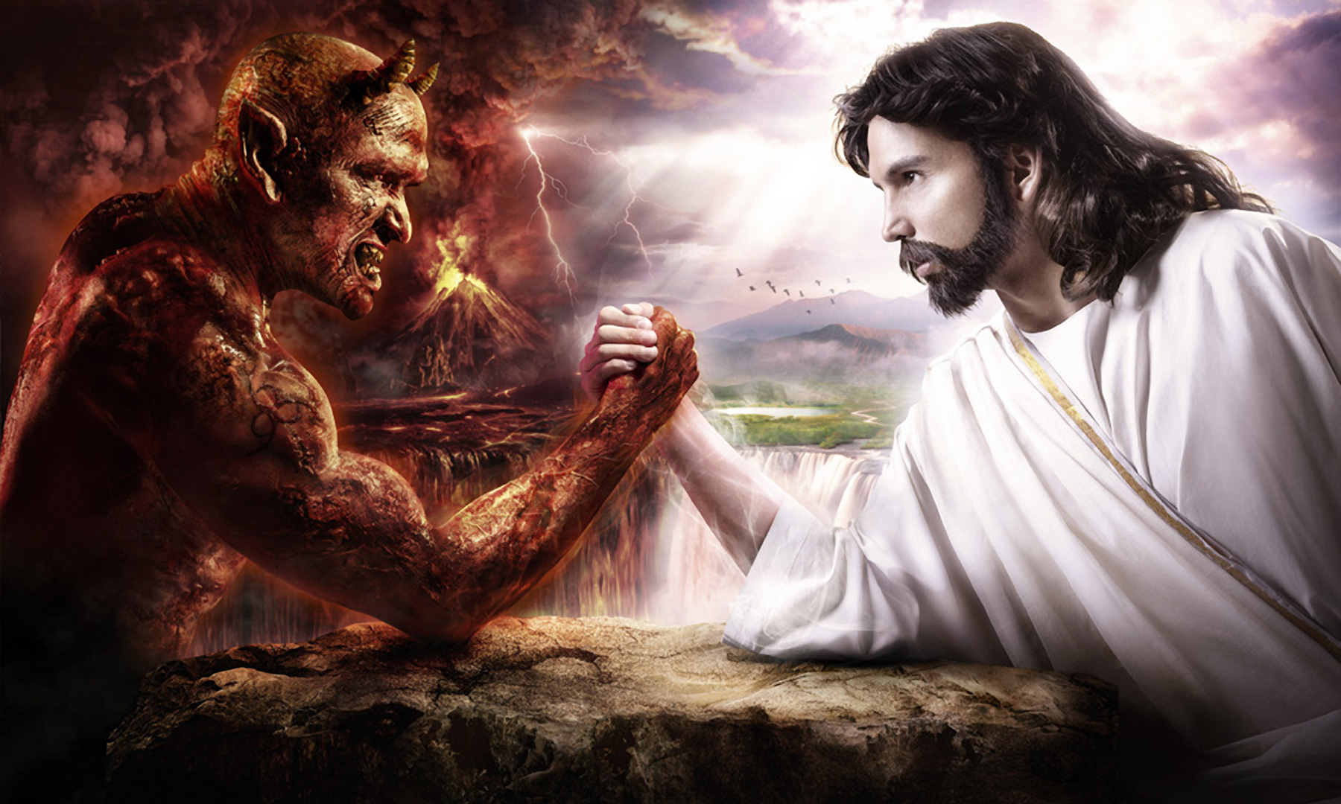
The main purpose of the Bible is to ensure that we have a good life on this earth.
As long as I try my best, God will let me into heaven.

Slide 20
What are the Bible’s
two main teachings?
God’s law which teaches me that I am a sinner and God’s gospel which tells me I am saved by Jesus.

Slide 21
What Are The Bible’s
Two Main Teachings?
Catechism Questions 13-17
January 28, 2018

